Slide 1







SQL
SPEAK THE LANGUAGE OF DATA
BY
DEVADHARSHINI RADHAKRISHNAN

Slide 2



What is SQL?
SQL - Structured Query Language.
domain-specific programming language.
Used for storing and processing information in a relational databases.
Interact with RDBMS.
It was developed in the 1970s by IBM computer Scientists & became a standard of thr American National Standards Institute(ANSI) in 1986 .
The international Organization for Standardization(ISO)
in 1987

Slide 3



What can SQL Do
Create Databases and Tables
Insert Data into tables
Retrieve Data (Querying)
Update existing Data
Delete Data
Filter and sort Data
Join Data from Multiple Tables
Set rules with constraints
Perform calculations and aggregations
control access to Data
Create indexs for faster searches
Use transactions to mange data safely
Use triggers to automate actions

Slide 4


DATA
Data is a collection of raw facts and figures
It can be numbers, text, images, audio ets
example:
name like - ‘alex’
number like - 23
DATABASE
It is a organized collection of interrelated data stored in a strucutred way so it can be easily accessed, managed and updated
it stores data in tables
example:
name:alex
age:23
DATA & DATABASE

Slide 5



Software which is used to manage, create and operate the database.
It provides an interface (GUI or command-line) to perform various operations
creating database and tables
inserting, updating and deleting data
querying data using SQL
It provide protection and security to the database in case of multiple users, it also maintain data consistency
DBMS
commonly used DBMS
Oracle Database
MySQL
MangoDB
Postgre SQL
Maria DB
MS SQL server
IBM DB2
Microsoft Access

Slide 6
RDBMS
It is a type of DBMS that stores data in a structured format, using rows and columns(tables)
It establishes relationship between tables using constraints such ans primary keys and foreign keys to maintain data integrity and ensure consistency
SQL is typically used to interact with RDBMS, enabling users to perform operations like querying, updating and managing the reational datbase

Slide 7



What Applications use SQL?
Website - store user accounts, comments, posts
Banking - manage accounts, transactions
E-commerce - product detials, orders, payments
Healthcare - Patient records, appointments
Education - student results, attendence
Business intellligence - Data reporting, dashboards

Slide 8

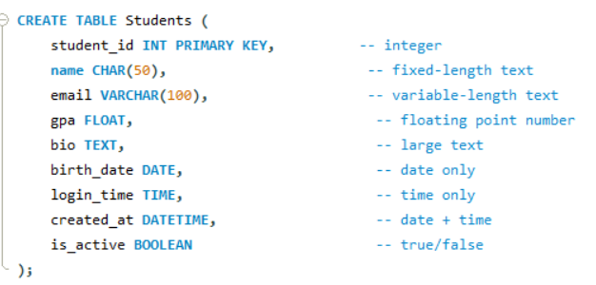

DATA TYPES
INT - Whole numbers( no decimals)
CHAR(n) - Fixed - length text
VARCHAR(n) - Variable - length text
FLOAT - Numbers with decimal poins
TEXT - Large text blocks
DATE - stores only YY-MM-DD
TIME - stores only H-M-S
DATETIME - stores both date and time
BOOLEAN - True/False values

Slide 9
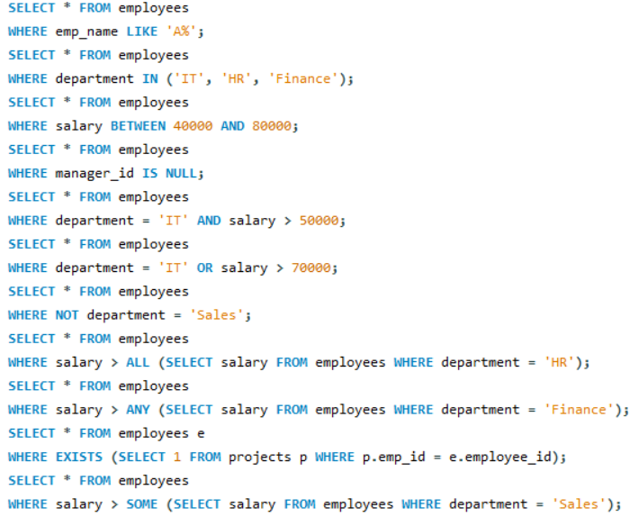
SQL Logical Operators
Allows you to use multiple comparison operators in one query
LIKE - Allow to match similar values, instead of exact values
IN - Allows to specify a list of values
BETWEEN - Select onlt rows within a range
IS NULL - Select rows that contain no data in a given column
AND - Select only rows that satisfy two conditions
OR - Select rows that satisfy either of two conditions
NOT - Select rows that do not match a certain conditions
ALL - TRUE if all of the subquery values meet the condition
ANY - TRUE if any of the subquery values meet the condition
EXISTS - TRUE if the subquery returns one or more records
SOME - TRUE if any of the subquery values meet the condition

Slide 10

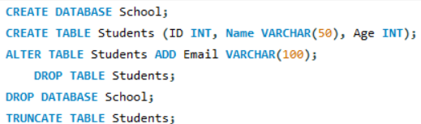
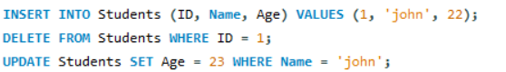
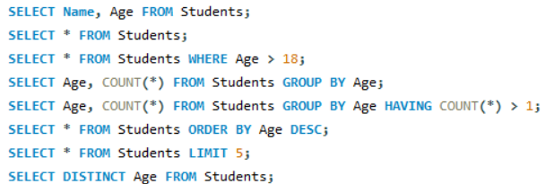
SQL COMMAND
DDL - Data Definition Language, Used for defining, altering and deleting database structures such as tables, indexa and schemas
CREATE - Create database or its ojects
(tables, index, functions, views, store, procedure and triggers)
DROP - Delete the objects from the database
ALTER - Alter or modify the structure of the database
TRUNCATE - Remove all the records from a tables
DML - Data Manipulation Language, Manipluation of data present in the database
INSERT – Insert data into table
UPDATE - Update existing data within a table
DELETE - Delete records from the database table
DQL - Data Query Language, Get some schema relation based on the query passed to it. This command allows getting the data out of the database to perform operations with it
SELECT - It is used to retrive data from the database
FROM - Indicates the table from which to retrive data

Slide 11
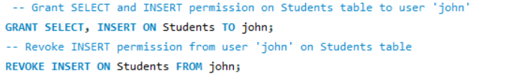
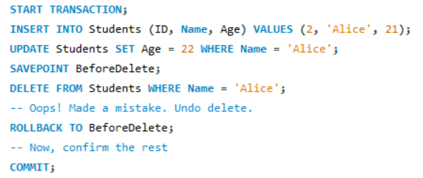
SQL COMMAND
DCL - Data Control Language ,control the access of data stored in a database, controlling privileges in the database
GRANT - Grants permission to one or more users to perform specific tasks
REVOKE -withdraws the access permission given by the GRANT statement
TCL - Transaction Control Language, manage transactions in the database. manage the chnage made to the data in a table by DML statement
COMMIT - saves any transaction into the database permanently
ROLL BACK - restores the database to last commit state
SAVEPOINT - temporarily save a transaction so that you can rollback

Slide 12

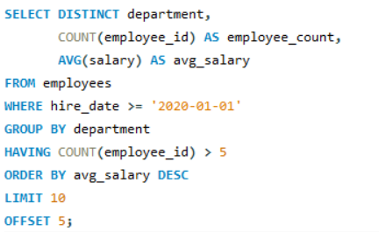

CLAUSES FOR QUERYING AND FILTERING DATA
WHERE - filters rows before any grouping or aggregation is done
GROUP BY - group rows that have the same values in specified columns. often used with aggregate functions
HAVING - filters the results of group by based on sggregate conditions
ORDER BY - sorts the results set by one or more columns. default is ascending (ASC) use DSC for descending
LIMIT - restricts the number of rows returned in the result set
DISTINCT - remove duplicate rows from the result set
OFFSET - Skips a specific number of rows before returning result

Slide 13
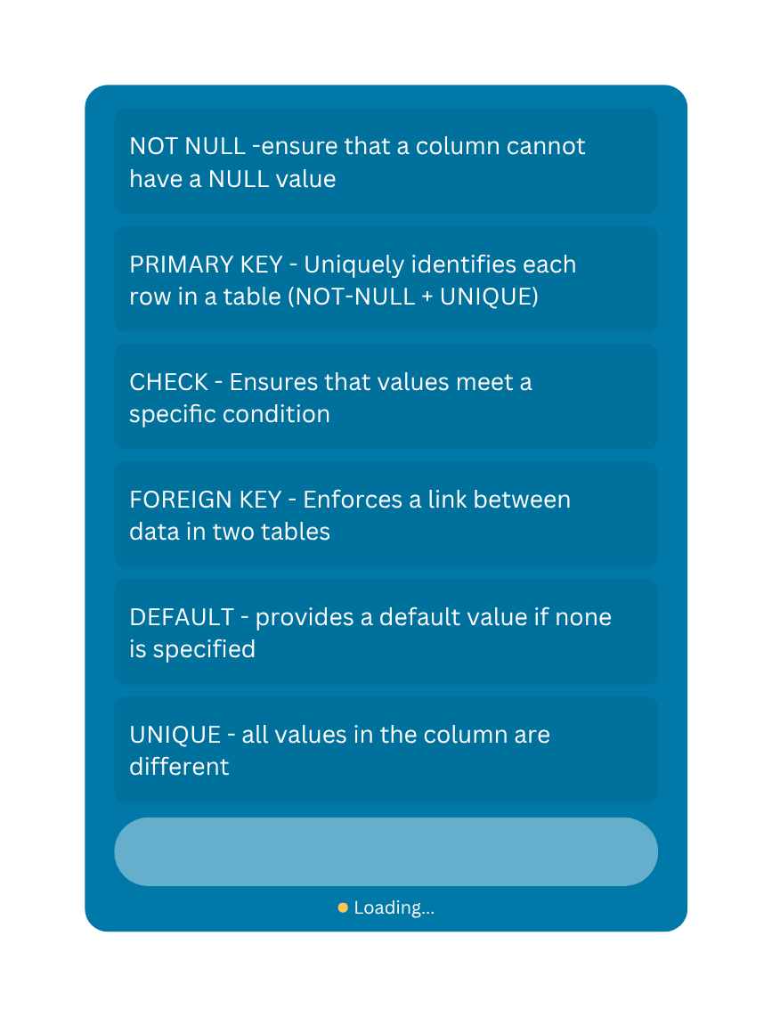
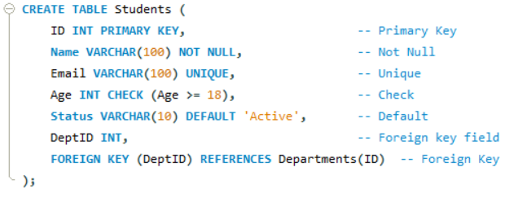

TYPE OF CONSTRAINTS
Constraints ensure database integrity and accuracy

Slide 14
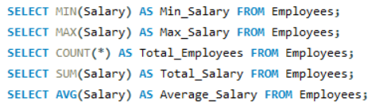
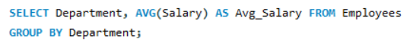
AGGREGATE FUNCTIONS
COMMON SQL AGGREGATE FUNCTION
MIN() - Return the smallest value
MAX() - Return the largest value
COUNT() - Return the number of rows
SUM() - Returns the total sum
AVG() - Returns the average value
Perform a calculation on a set of values.
returns a single summarized ewsult (e.g., total, average,count)
Often used with the GROUP BY caaluse to work with group of data
Used to data efficiently, get summarized insights and usefull for reporting and dashboards
Work in multiple rows
With group by

Slide 15
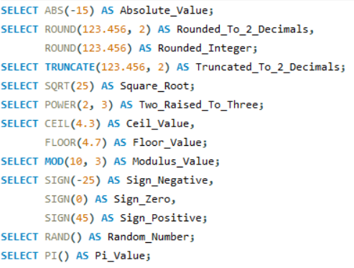
NUMERIC FUNCTIONS
COMMON SQL NUMERIC FUNCTION
ABS(x) - Returns the absolute (positive) value of the number
ROUND(x,d) - Rounds a number x to d decimal places
TRUNCATE(x,d) - Truncates a number od x to d decimal places without rounding
SORT(x) - Returns the square root of x
POWER(x,y) - Returns x raised to the power of y
CEIL(x) or CEILING(x) - Returns the smallest integer greater than or equal to x
FLOOR(x) - Returns the largest integer less than or equal to x
MOD(x,y) - Returns the remainder when x is divided by y
SIGN(x) - Returns -1 if x is negative , 0 if zero, i if possitive
RAND() - Returns a random decimal between 0 to 1
PI() - Returns the value of pi
Performing mathematical and arithmetic operations in numeric data
Allow us to manipulate numbers, perform calculation and aggregate data for purpose of reporting and analysis

Slide 16
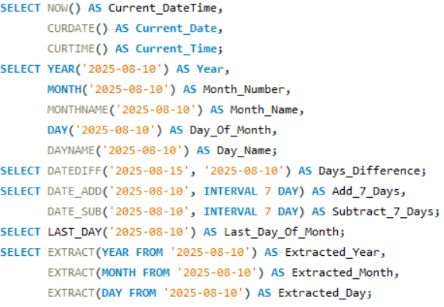
DATE FUNCTIONS
COMMON SQL DATE FUNCTION
Built - in function that allow us to work with, manipulate and retrive information from date and time values
– extracting parts of a date
– adding or subracting time intervals
– formatting date/ time output
– calculating differences between dates
NOW() - Returns the current date and time
CURDATE() - Returns the current date
CURTIME() - Returns the current time
DATE() - Extracts date from a datetime value
YEAR() - Returns the year
MONTH() - Returns the month number( 1to 12)
MONTHNAME() - Returns the month name
DAY()/DAYOFMONTH() - Returns the day of the month
DAYNAME() - Return the weekday name
DATEDIFF(D1,D2) - Difference in days between two dates
DATE_ADD() - Add intervsl to a date
DATE_SUB() - Subract interval from a date
LAST_DAY() - Returns last day of the month
EXTRACT() - Extracts part of a date

Slide 17
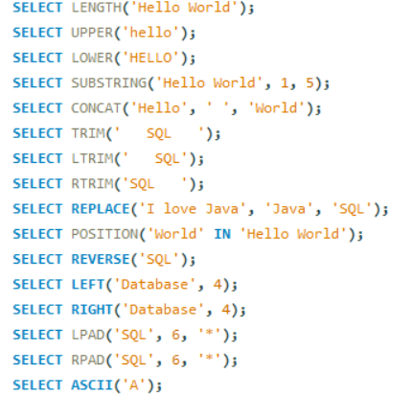
COMMON SQL STRING FUNCTION
STRING FUNCTIONS
LENGTH() - Finds length of a string
UPPER() - converts to uppercase
LOWER() - converts to lowercase
CONCAT() - joins strings together
SUBSTRING() - extracts part of a string
REPLACE() - replaces text in a string
LTRIM() - Removes spaces from the left
RTRIM() - Removes spaces from the right
TRIM() - Removes spaces from both sides
INSTR() - Finds position of substring
REVERSE() - reverse a string
REPLACE() - Replaces part of the string
POSITION() / LOCATE() - Finds position of substring
LEFT() - Gets first N characters
RIGHT() - Get last N characters
LPAD() - Pads string on left
RPAD() - pads string on right
ASCII() - Returns ASCII value of first charcter
Allow us to manipulate, format and extract specific parts of text data in database
essential tasks like cleaning up data, comparing strings and combining text fields

Slide 18
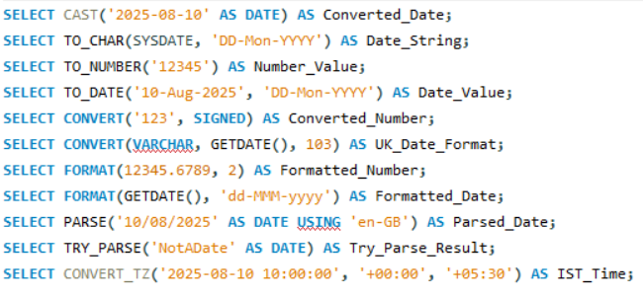
CONVERSION FUNCTIONS
COMMON SQL CONVERSION FUNCTION
Used to change data from one type or format ot another such as converting text to numbers, numbers to dates or formatting numeric values
These functions are essential when operations require data to be in a specific type, or when data needs to be presented in a different format
CAST() - Converts a value from one data type to another
TO_CHAR() - Converts numbers or date to a string (Oracle / PostgreSQL)
TO_NUMBER() - Converts a string to numeric type (Oracle / PostgreSQL)
TO_DATE() - Converts a string to a date (Oracle / PostgreSQL)
CONVERT() - Alternative to CAST() but also allows style formatting in SQL server (MySQL & SQL Server)
FORMAT() - Formats a number or date with specific decimal places or formatting rules
PARSE() / TRY_PARSE() - Parses a string into a specific data types, with error handling (SQL Server only)
CONVERT_TZ() - Converts a datetime from one time zone to another (MySQL)

Slide 19
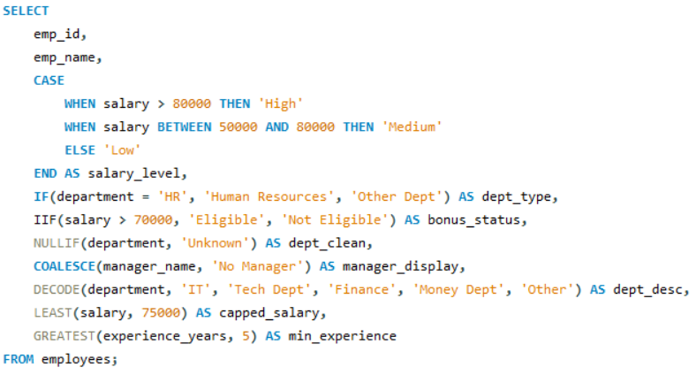
CONDITION FUNCTIONS
COMMON SQL CONDITION FUNCTION
Functions that let us apply logic - based decision - making directly inside the SQL queries - similar to using IF-THEN-ELSE in programming
Used to categorize, replace, handle nulls, avoid comples procedural code
They check a condition and return different values depending on whether the condition is true of false
CASE - Checks multiple conditions in order, returns first match
IF() - Returns one values if condition is true, else another
IIF() Short from a CASE
NULLIF() Returns NULL if both values are equal
COALESCE() - Returns first non_null values from a list
DECODE() - Acts like a simplifies CASE statement
LEAST() - Returns the smallest value from the list
GREATEST() - Returns the largest value from a list

Slide 20

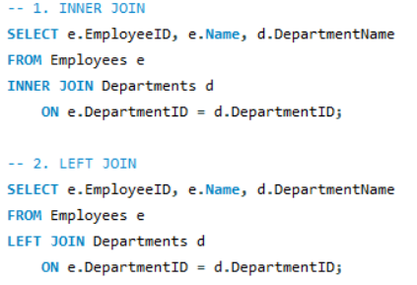
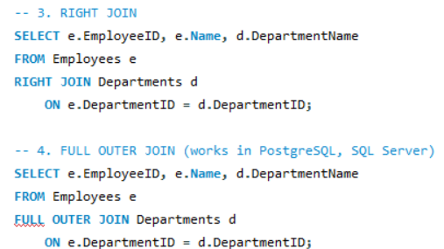
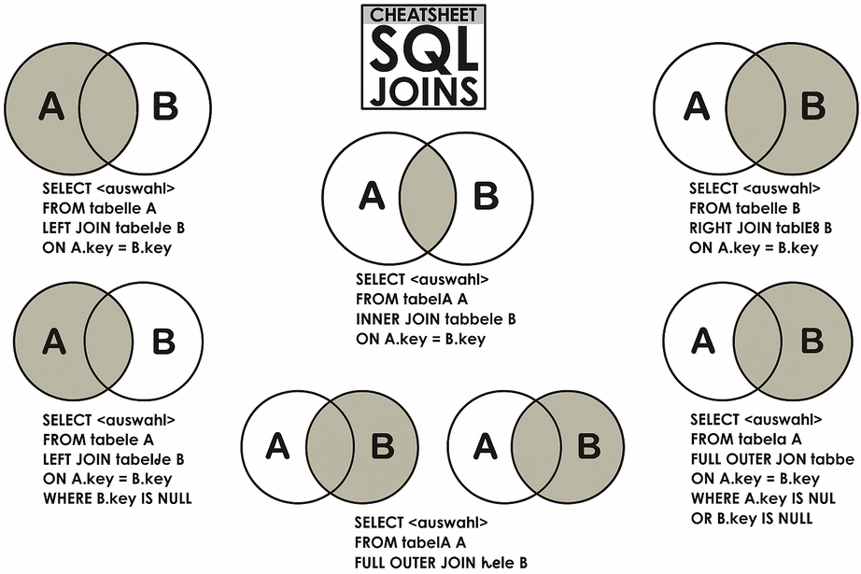

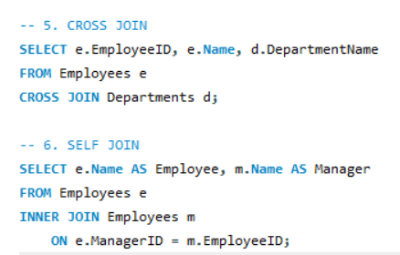
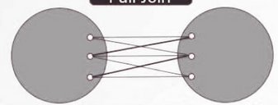
SQL JOINS
SQL JOIN is used to combine rows from two or more tables based on a related column between them
INNER JOIN
RIGHT JOIN
Returns all rows from the right table and matching rows form the left table
Returns only the matching rows from both tables
FULL JOIN
Returns all rows when there is a match in ethier table
LEFT JOIN
CROSS JOIN
produces the Cartesian product of two tables, resulting in each row from the first table being paired with every row from the second one
Returns all rows from the left table and matching rows form the right table

Slide 21


WINDOW FUNCTIONS
Perform calculations across a set of rows related to the current row
Unlike aggregate functions they do not collapse rows - they keep each row in the output
Introduced with the OVER() clause
OVER()
OVER() - Defines the “window”(set of rows) that the function will operate on
Works with window/ analytic functions
Unlike GROUP BY, it dones not collapse rows - every rows stays visible
function_name(column)
OVER (
[PARTITION BY column_list]
[ORDER BY column_list]
)
PARTITION BY - Splits data into groups (like GROUP BY, but keeps all rows)
ORDER BY - Defines calculation order insides each partition

Slide 22

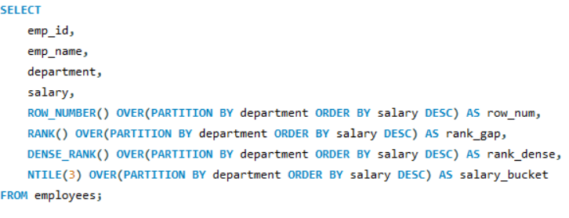
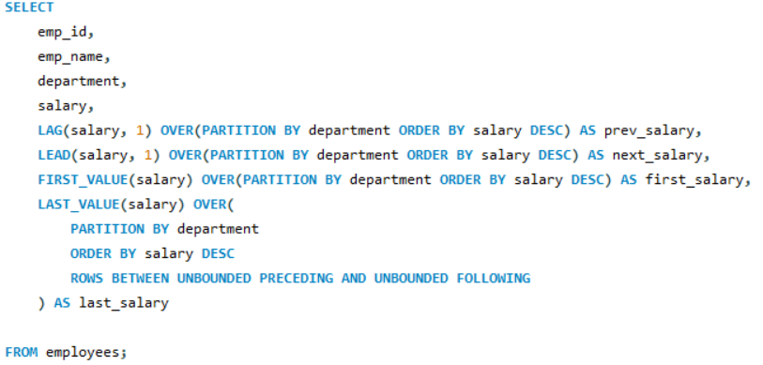
MAIN CATEGORIES OF WINDOW FUNCTIONS
RANKING FUNCTION
ROW_NUMBER() - Unique number per row
RANK() - Rank with gaps for ties
DENSE_RANK() - Rank without gaps for ties
NTILE(n)- Divides rows into n buckets
VALUE FUNCTION
LAG(column, offset) - Value from a previous row
LEAD(column, offset) - Value from the next row
FIRST_VALUE() - First value in the window
LAST_VALUE() - Last value in the window

Slide 23

SQL Subquery
Types of subquery
Query nested inside another SQL query. It allows us to perform complex filtering, aggregation and data manipulation by using the result of one query inside another. often inside a SELECT, INSERT, UPDATE OR DELETE statement or inside a WHERE clause
To perform operations that require intermediate results
To filter data based on the result of another query
To simplify complex SQL queries by breaking them into smaller parts
Single-Row Subquery
Multi-Row Subquery
Correlated Subquery
Non-Correlated Subquery

Slide 24

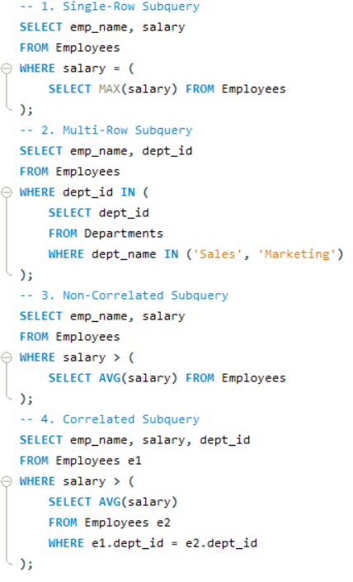


Types of Subquery
Single-Row Subquery - Returns only one row ( and one column) . usefull with comparison operators like =,<,>
Correlated Subquery - References a column from the outer query and runs once for each row of the outer query
Multi-Row Subquery - Returns multiple values of rows ( columns) , often used with IN, ANY or ALL
Non-Correlated Subquery - References a column from the outer query and runs once for each row of the outer query

Slide 25

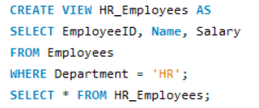
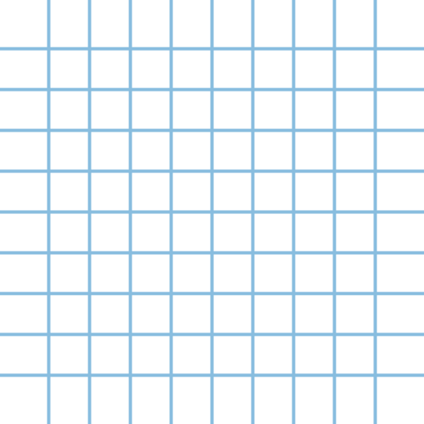

It is a virtual table that is based on the result - set of an SQL query
Usefull for simplifying complex queries or securing data access
It contains rows and columns just like a real table
Does not store data physically. It just stores the query
When you query a view, the SQL engine runs the stored query and returns the result
– Used to simplify comples queries
– Encapsulate frequently used queries
– Provide a level of abstraction and security
– Restrict user access to specific rows or columns
– Present aggregated or joined data asily
Syntax
CREATE VIEW view_name AS
SELECT column1, column2...
FROM table_name
WHERE condition;
SQL
Views

Slide 26
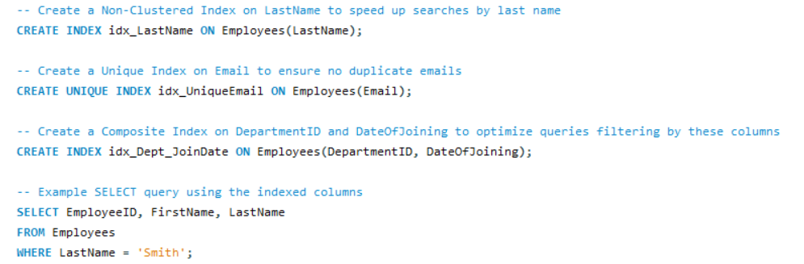
SQL INDEX
It is a schema object that improves the speed of data retrieval operations on a table
CLUSTERED INDEX
NON CLUSTERED INDEX
Sorts and stores the data rows in the table based on the key values
Only one clustered index per table (because rows can be stored only one way)
Perimary key often implemented as clustered index
Creates a separate structure that points back to the data rows
Can have multiple non-clustered indexs on the table
Speeds up searches on columns not part of the clustered index
UNIQUE INDEX
COMPOSITE INDEX
ensures all values in the index key are unique
An index on multiple columns

Slide 27




Triggers are like reflex action which allow us to set up an automatic action that will run every time a certain event happens in our database like adding, updating etc,..
Used to automatically logging changes, Enforcing comples business rules, Maintaining derived/calculated data, Sending alerts/ notifications
Syntax
CREATE TRIGGER trigger_name
[BEFORE | AFTER] [INSERT | UPDATE | DELETE]
ON table_name
FOR EACH ROW
BEGIN
-- SQL statements
END;
Trigger types
BEFORE Trigger
AFTER Trigger
INSTEAD OF Trigger
SQL Trigger

Slide 28



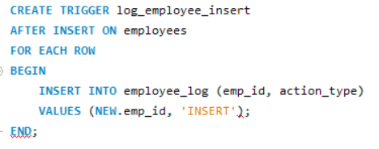
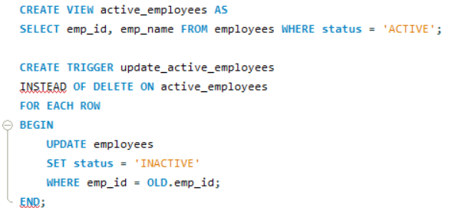

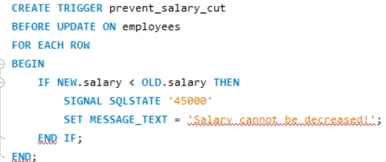
Trigger Types
AFTER Trigger
Runs after the action
Create logs after data changes
INSTEAD OF Trigger
Replaces the action
Used on views to define custom INSERT/UPDATE/DELETE behavior
BEFORE Trigger
Runs before the action
Validate or modify data before insertion

Slide 29


STORED PROCEDURE
It is a precompiled set of SQL statements stored in the database that you can execute as a single unit
Usefull for reusability, security and performance optimization
Syntax
Stored in the database - can be called anytime without rewriting code
Precompiled - database engine parses and optimises it once
Reusable - You can call it multiple times in different applications
Parameter support- accepts input parameters and returns output parameter
Security - Can restrict access so users only execute the procedure instead of running direct SQL queries
Create stored procedure
CREATE PROCEDURE procedure_name
AS
sql_statement
GO;
Ececuting a stored procedure
EXEC procedure_name;

Slide 30
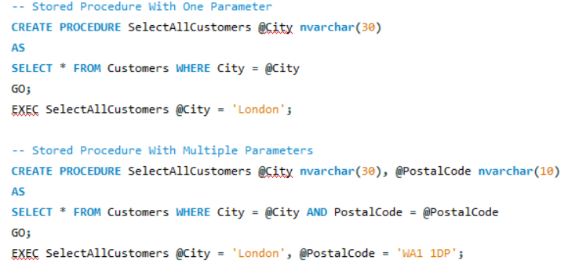

STORED PROCEDURE
With one parameter
SQL Statement creates a stored procedure that selects customers form particualr city form the “customers ” table
With multiple parameter
SQL Statement creates a stored procedure that selects customers form particualr city with a particular postalcode form the “customers ” table

Slide 31

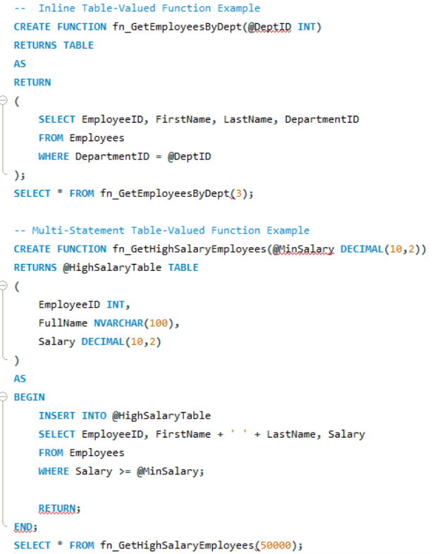
TABLE - VALUED FUNCTIONS
User - defined function that return data in the form of a table.
Which can be used like a regular table in SELECT queries
Its often used when you want to escapsulate reusable queries that return multiple rows and columns
Types
INLINE TABLE - VALUED FUNCTION
Acts like a parameter view
Contains only one SELECT statement (no procedural cod)
Faster because it’s optimised like a view
MULTI - STATEMENT TABLE -VALUED FUNCTION
Allows multiple statements inside
You define the table structure in the RETURNS clause, and populate it using INSERT

Slide 32

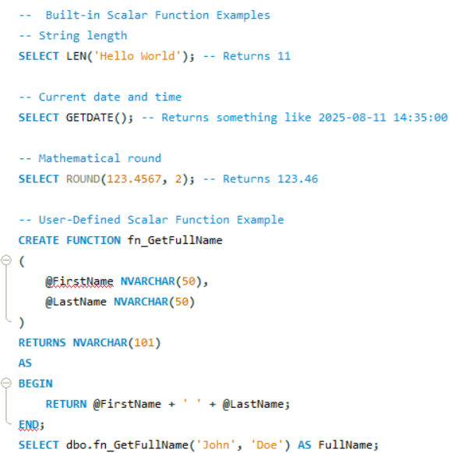
Types
SCALAR FUNCTIONS
User-defined or built in function that returns a single value (not a table)
It takes zeros or more parameters, performs an operation, output one value of a specific data types — such as INT, DECIMAL, VARCHAR,DATE , etc,.
BUILT-IN SCALAR FUNCTIONS
Already provided by SQL server/MySQL/PostgreSQL (eg, GETDATE(), LEN(), ROUND()
USER-DEFINED SCALAR FUNCTION
Create them ourself using CREATE function

Slide 33


NORMALIZATION
It is the process of organizing data in a database to reduce redudancy and improve data integrity
Preventing issues when inserting, deleting and updating records, ensuring the data remains efficient, consistent and accurate
Why its important ?
Types
First Normal Form (1NF)
Second Normal Form(2NF)
Third Normal Form (3NF)
Boyce–Codd Normal Form (BCNF)
Reduce data redundancy (duplication)
helps to avoid sorting the same information in multiple items
Prevents anomalies
Helps prevent error when adding, removing, or deleting data

Slide 34

NORMALIZATION
TYPES
RULES
Each table cell should contain a single value and each column must have a unique name. No repeating group/arrays
1NF
All non key attributes must depend on the primary key.In simple term each piece of data in the table should relate directly to the main identifier
2NF
Every non-key attributes must be independent of other non-key attributes . It means that no information in the table should rely on another piece of data
3NF
Every determine ( an attributes that can determine other attributes) must be a candidate key, This ensure that all the dependencies are based sobly or unique identifier
BCNF

Slide 35

Thank You
Devadharshini Radhakrishnan
devadharshini.radhakrishnan06@gmail.com
https://www.linkedin.com/in/devadharshini06-r/

